Slide 1
CS 447/647
Shells
Notes:
The first process that runs inside the initial ram fs is init
init is a shell script
What does it do? init finds the real root fs
It receives params from grub (bootloader) about uuid of a fs or the path to a disk
init parses those args to mount a disk
Traditionally rootfs is on a local disk, but init ramfs allows rootfs to be anywhere (nfs, iscsi, etc.)

Slide 2
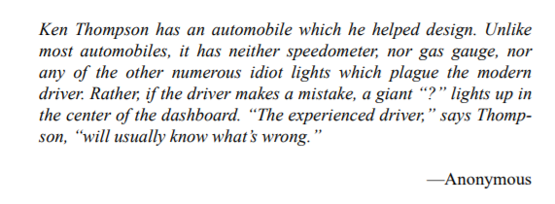
Notes:
Quote from the unix hater’s handbook
Thompson shell was 500 lines
Modern shells have hundreds of thousands of lines
A shell is a collection of tools that can be composed to solve problems

Slide 3
Overview
What is a shell?
What are commands?
What are ELF binaries?
How are binaries located?
How are shared libraries located?
How do we build a dynamic user space?
Notes:
ELF - Executable and Linkable Format
Spack and rootless containers
Spack was created by lawrence livermore national lab to compile whatever they need on HPC systems

Slide 4
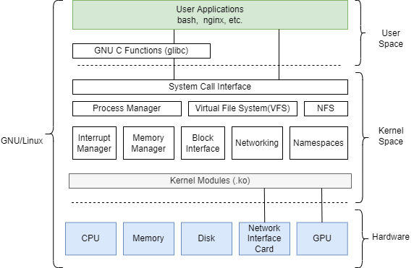
Notes:
System calls are how users interact with the kernel space
System calls - open, read, write, close (part of POSIX standard, maintained by IEEE)
Process manager - scheduler
VFS - abstraction layer that provides an interface for different filesystems (ext4, XFS, NTFS, etc.)

Slide 5
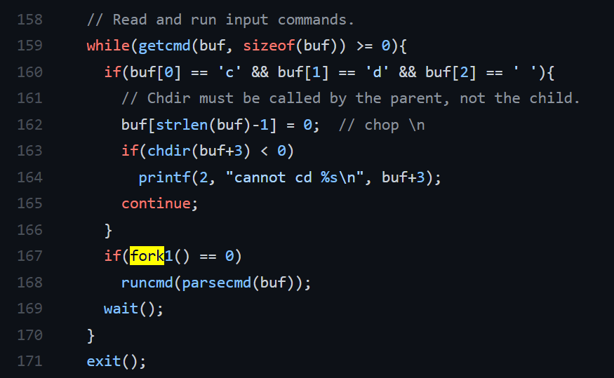
What is a shell?
A command interpreter
fork()
exec()
wait()
cd
run
https://github.com/mit-pdos/xv6-public/blob/master/sh.c Line 158
Notes:
Fork - create child process, deprecated for clone
Exec - run something
Wait

Slide 6
What does it interpret?
Commands typed by a user or read from a file.
Symbols: <>|&$`()
Keywords: cd, if, while, for, exit
Searches for the commands on the system.
PATH environment variable
What does it execute?
language features
|
for, if, while, function
ELF binaries*
Notes:
< redirect from file to stdin
> redirect stdout into a file
>> redirect stdout to append to a file
| redirect stout to stdin (pipe)
& runs command in the background
$ for variables
` command substitution
() numerous uses, including arithmetic
Keywords are not binaries
PATH is treated as a stack

Slide 7
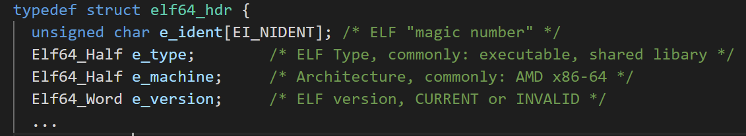
https://github.com/torvalds/linux/blob/master/include/uapi/linux/elf.h
man 5 elf

Slide 8

GNU coreutils (ELF binaries)
Core utilities which are expected to exist on every operating system
head tail
wc
md5sum sort shuf
uniq
comm split tr basename mktemp uptime
ls rm cp mv ln chgrp chown chmod echo printf tee
false
https://www.gnu.org/software/coreutils/

Slide 9
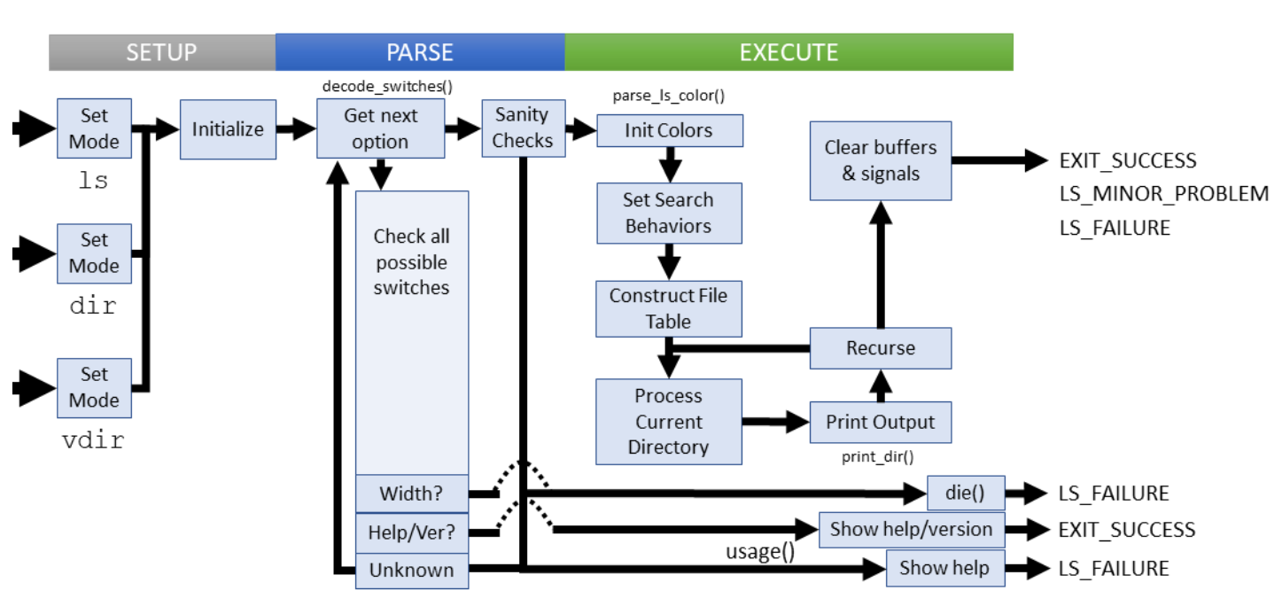
ls(1)
https://www.maizure.org/projects/decoded-gnu-coreutils/ls.html

Slide 10
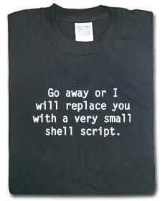
Why do we use a shell?
Managing Services and Hardware
Application Layer Protocols
DHCP, DNS
Engineering and Research
Scripting
Glueing
Debugging
Modify runtime parameters
Notes:
Slurm written in bash

Slide 11

Why are shells still popular?
Lightweight
Accessibility
Blanket exception for CLI applications
Receive Federal money, must be accessible
Ease of use*
Reproducibility
Automation
Change Control
git
Notes:
Busybox for embedded systems
Windows server is not easily reproducible

Slide 12
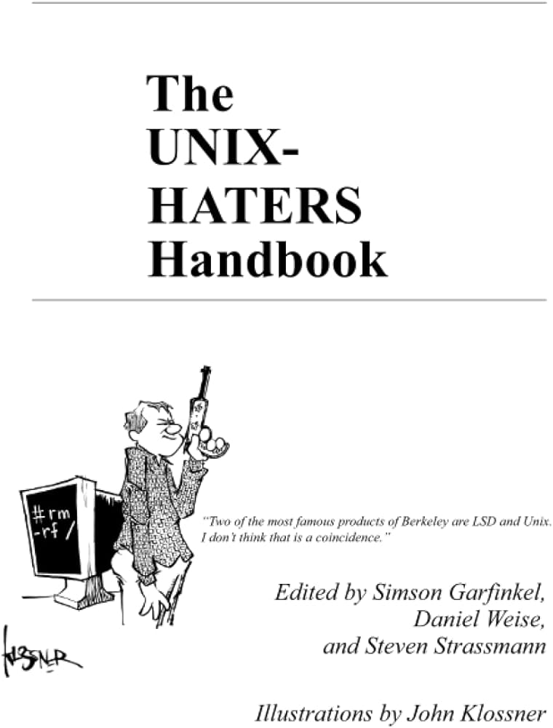

Slide 13






MIT - $1,000,000 in attorney fees
Lazar, J. Managing digital accessibility at universities during the COVID-19 pandemic. Univ Access Inf Soc (2021). https://doi.org/10.1007/s10209-021-00792-5
Notes:
US universities involved in legal actions, due to inaccessible technology used on campus and in education.
it means that for now the ability to bring website claims under the ADA remains intact.

Slide 14
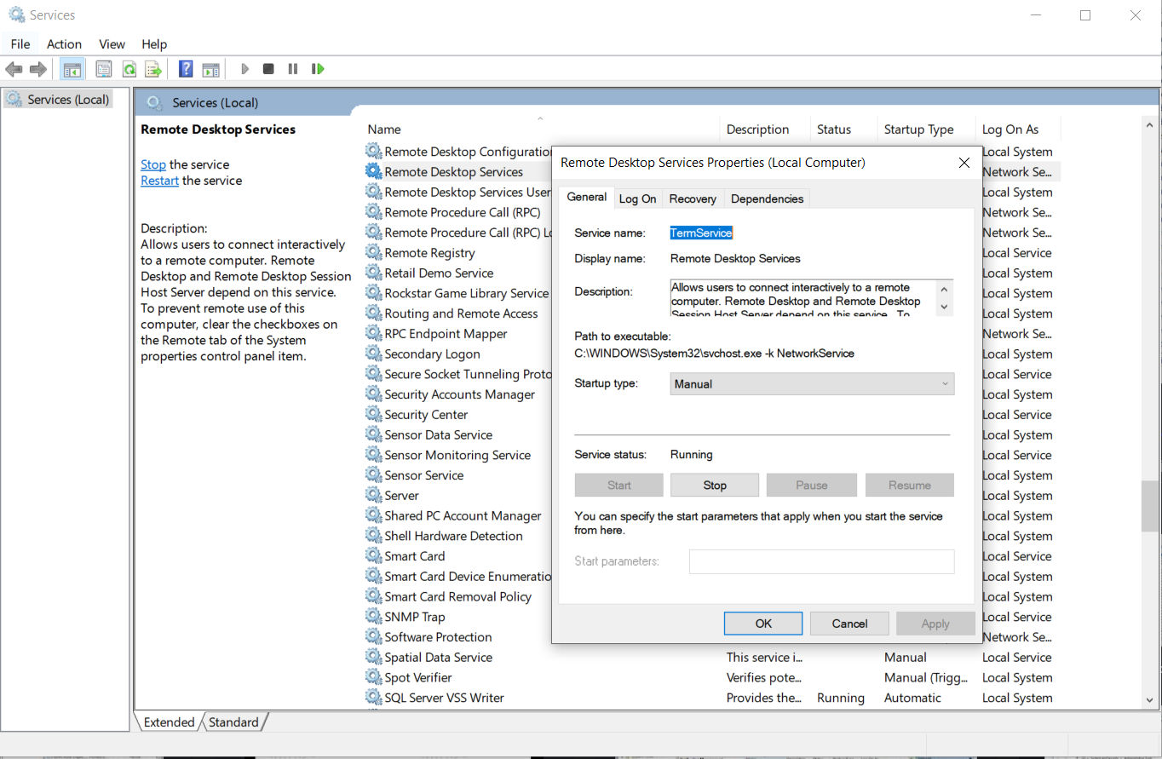
Example - Windows Service Management

Slide 15
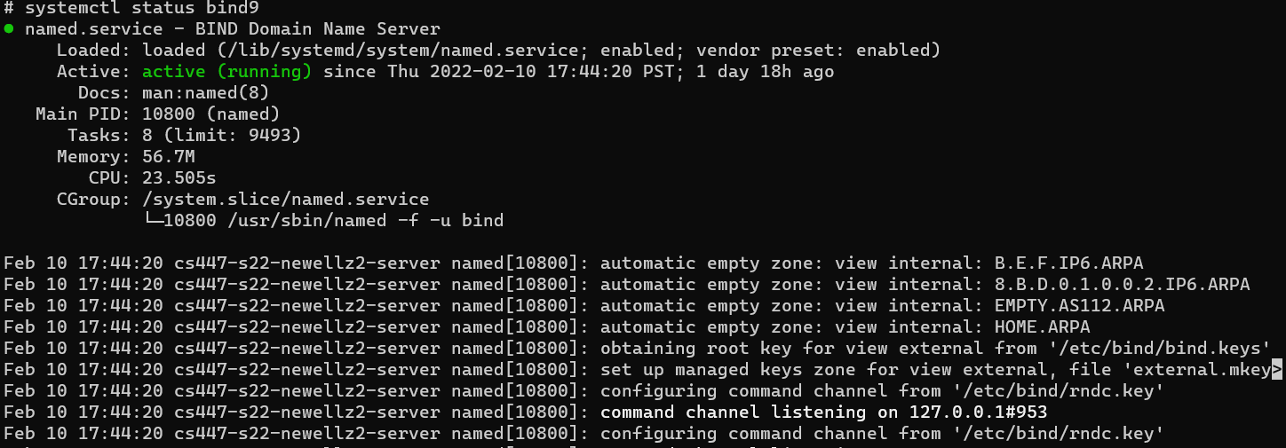
Example - Linux
systemctl restart bind9
systemctl status bind9

Slide 16
bash configuration and dotfiles
/etc/bash.bashrc - System-wide .bashrc file for interactive bash(1) shells.
/etc/profile - Profile file for sh(1) and bash(1)
/etc/profile.d - Collections of profile scripts. Often used for $PATH modifications
modules!
~/.bashrc - Interactive shell configuration file
~/.bash_profile - Executed for login shells

Slide 17
Best way to learn bash?
Use it!

Slide 18
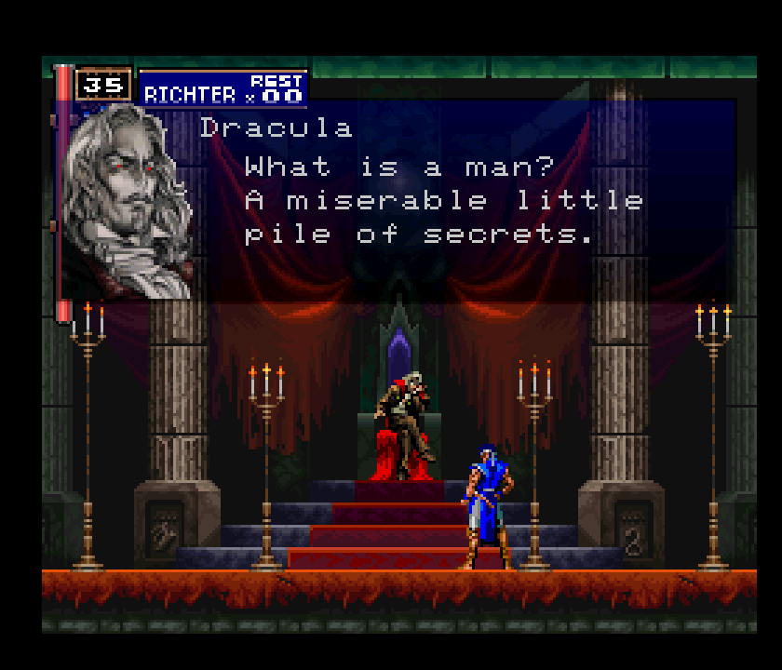
Getting help - man(1)
manpage?

Slide 19
“Classic Unix documentation is written to be telegraphic but complete… The style assumes an active reader, one who is able to deduce obvious unsaid consequences of what is said, and who has the self-confidence to trust those deductions. Read every word carefully, because you will seldom be told anything twice.”
Eric Raymond

Slide 20
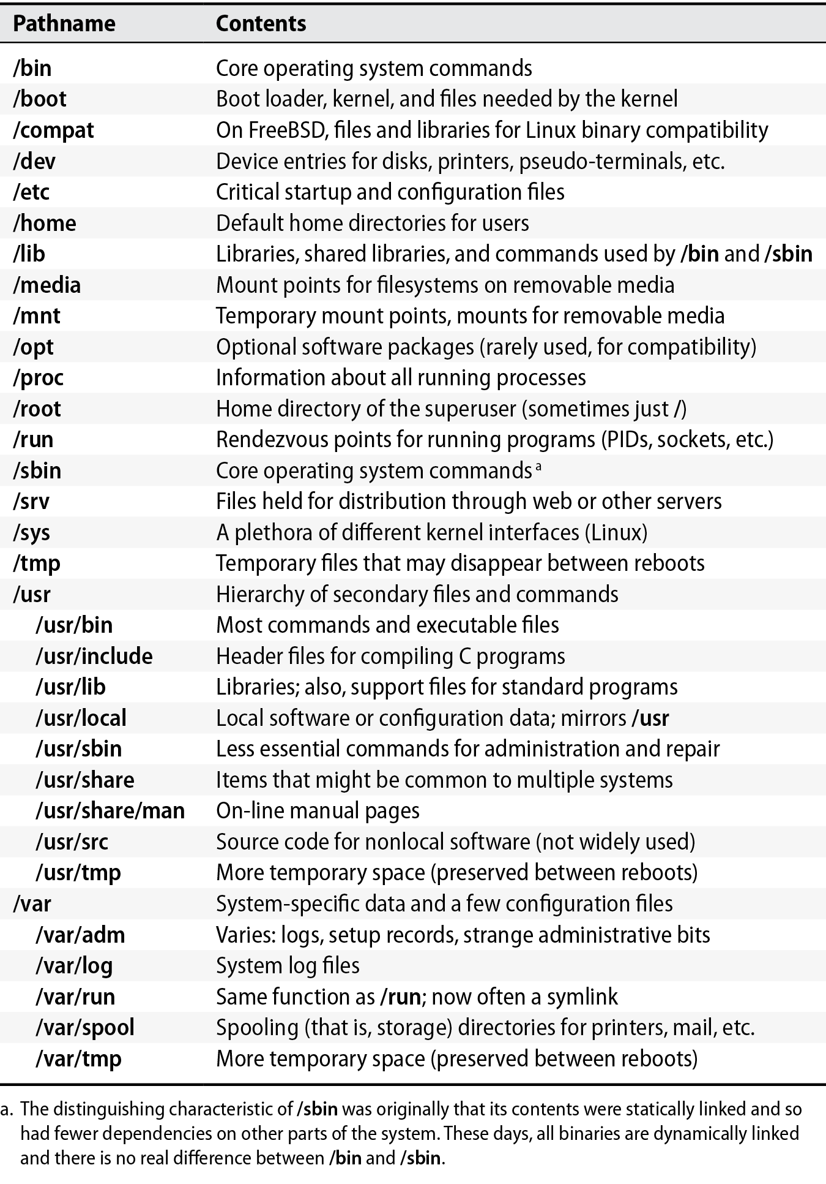
Notes:
* They must be used on a graphics display to work on a document.
* Most of the WYSIWYG systems are either non-free or are not very
portable.
* 'troff' is firmly entrenched in all Unix systems.
* It is difficult to have a wide range of capabilities within the
confines of a GUI/window system.
* It is more difficult to make global changes to a document.

Slide 21
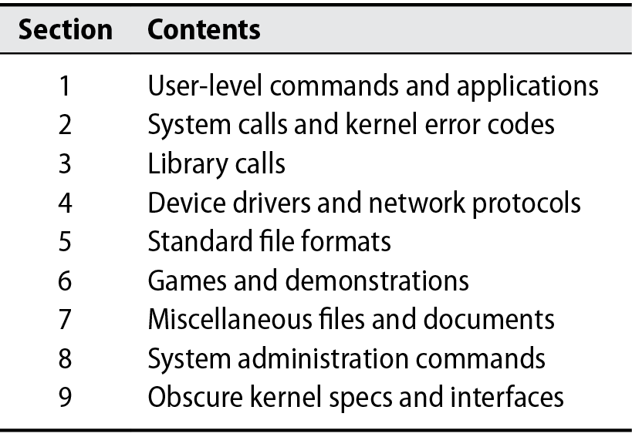
manpage sections

Slide 22
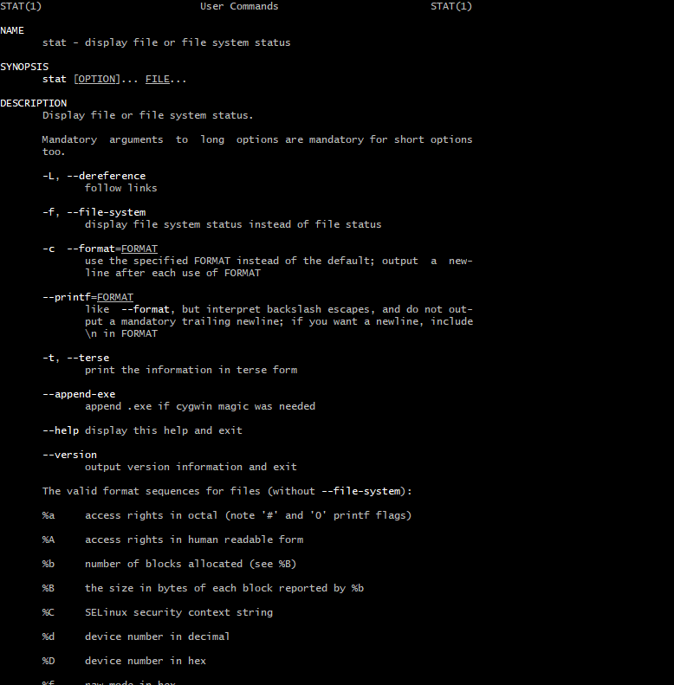
man

Slide 23
How are man pages rendered?
groff
System for typesetting documents
Similar to TeX..
troff in 1971.
groff in 1990
More like a compiler
Text input files with embedded formatting
man 7 groff_man
Notes:
“run off a document”
The g is stands for grandpa, jk it’s gnu roff
Who says we don’t teach you anything contemporary. Calculus is 400 years old…
Tour of an older Unix system
Insight into modularity and design philosophy

Slide 24
man
apt install -y man manpages manpages-dev info groff
mandb #Regenerate manpages from roff source. #Config in /etc/manpath.config
man -k ext4 # Keyword search for string “ext4”
man -K ext4 # Page through manpages that contain ext4
man -a intro # Page through the intro manual
man ls # manpage for ls
# Why do we need any of this when Google exists?
Notes:
Offline use in air gapped systems
Differences in versions

